Slide 1

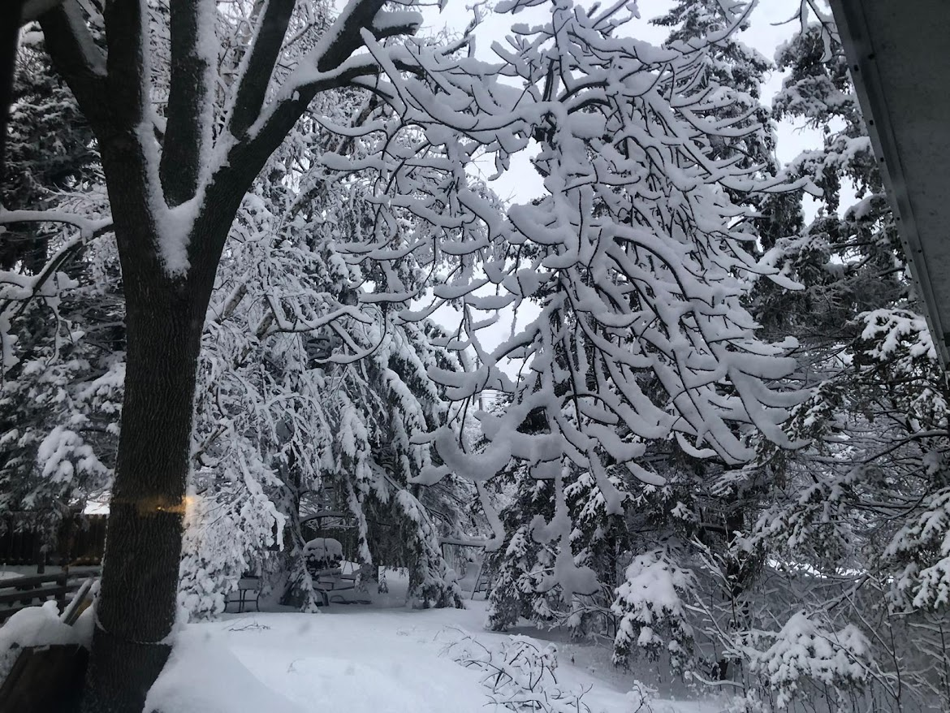
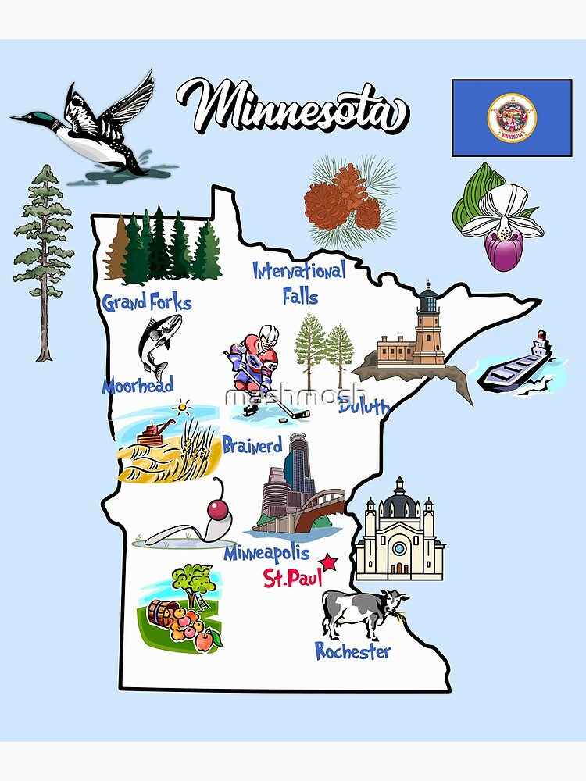
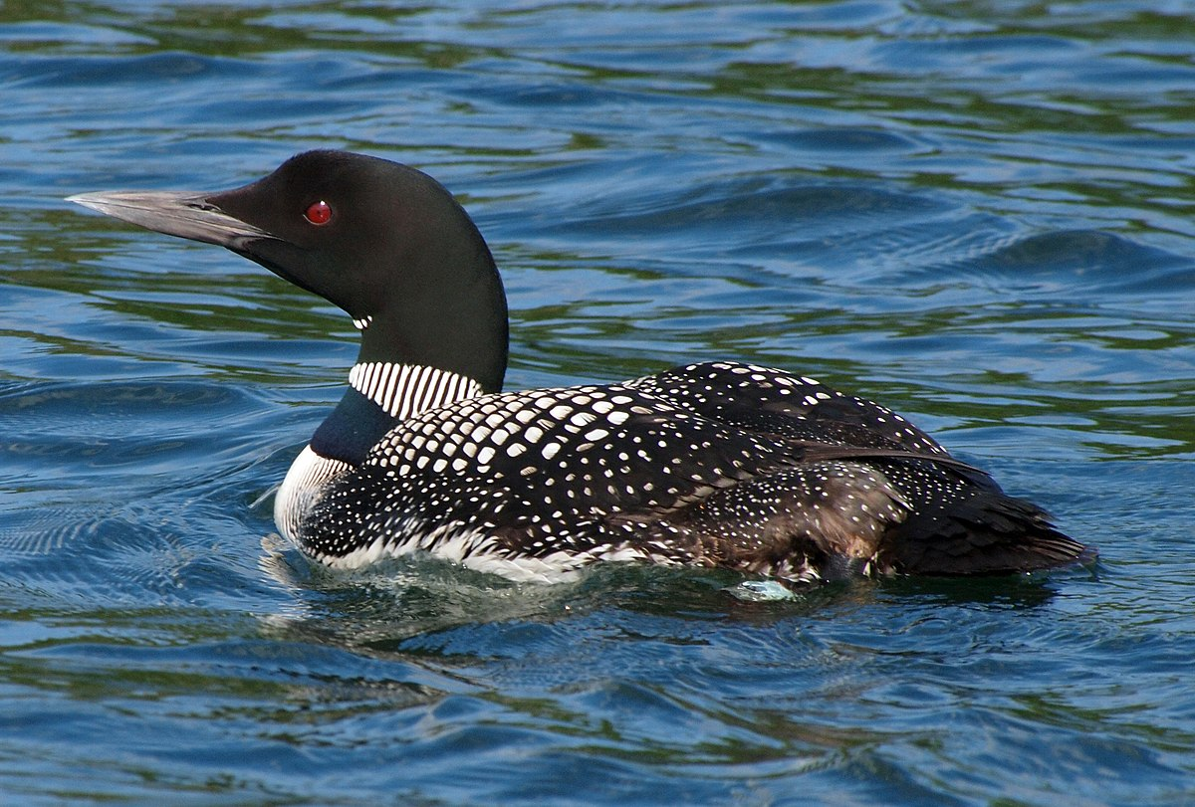
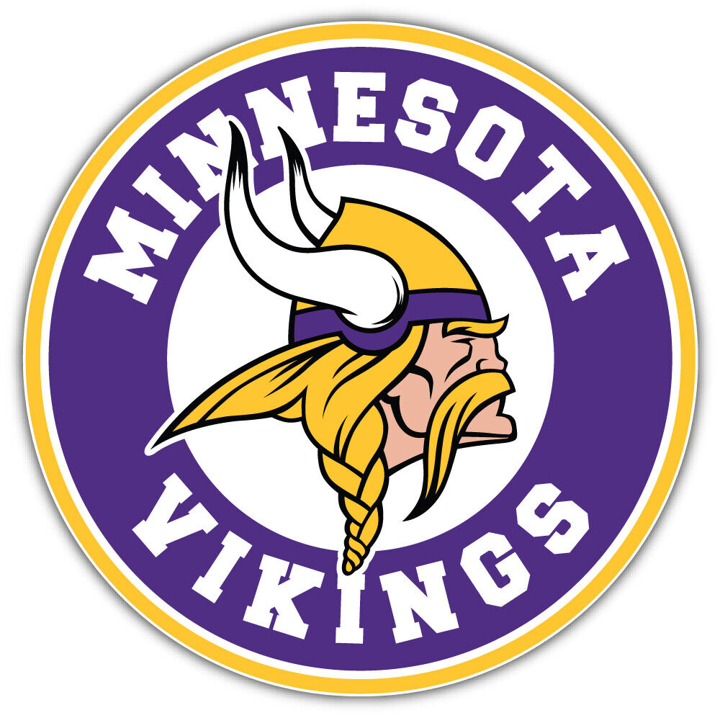
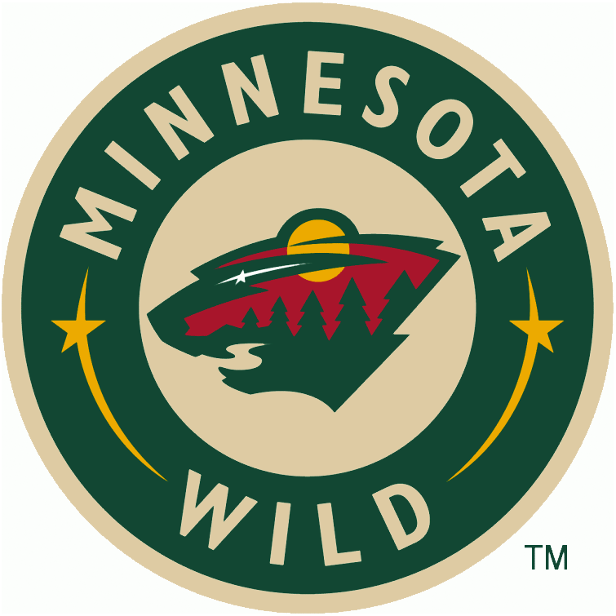
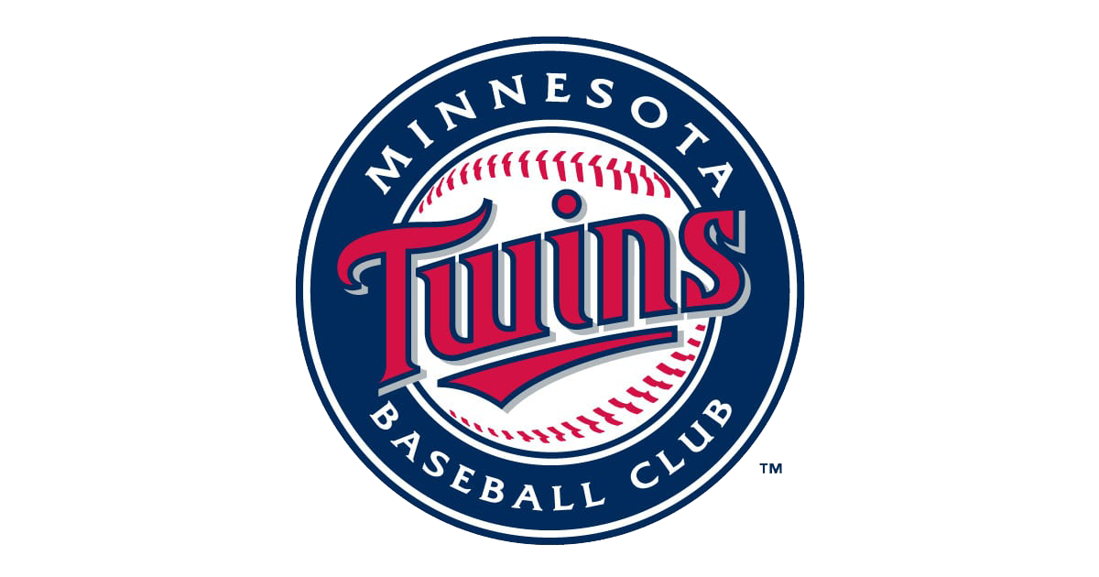
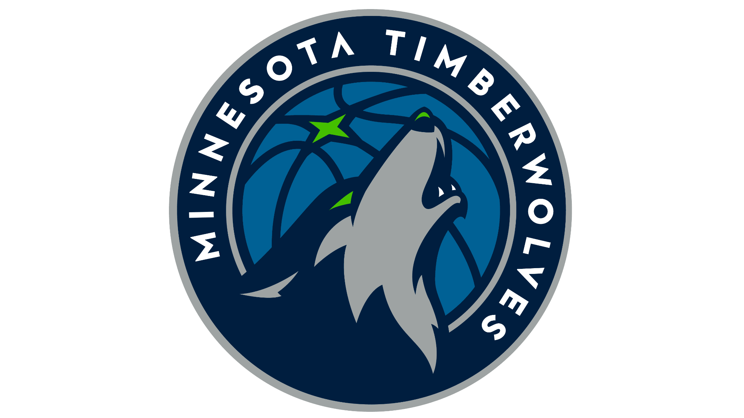
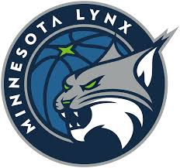
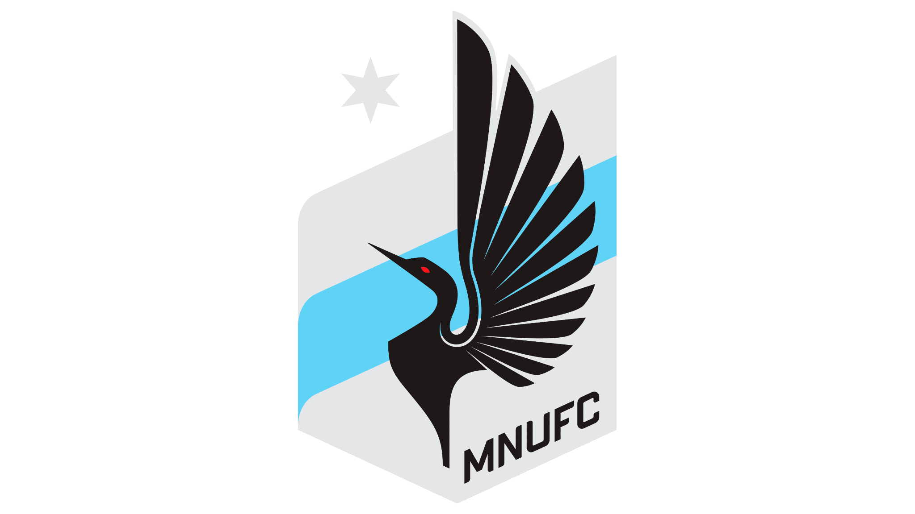
Minnesota
By Rhett Olson

Slide 2
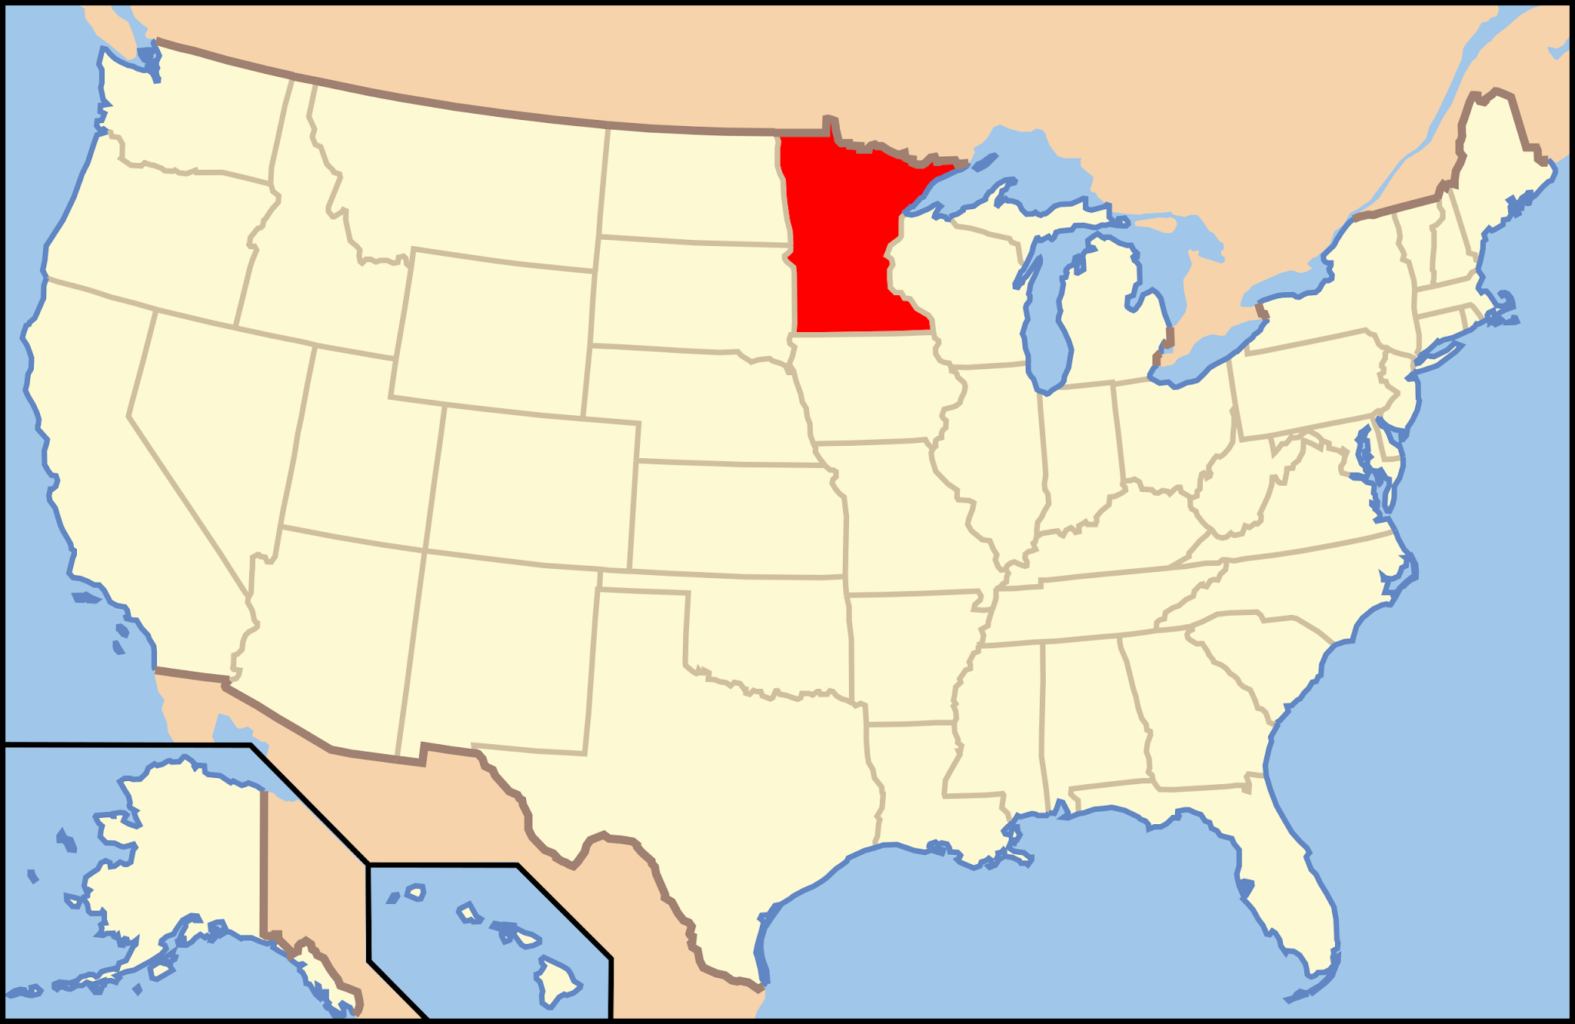
Where is it?

Slide 3
Where is it?
How am I supposed to remember that?

Slide 4
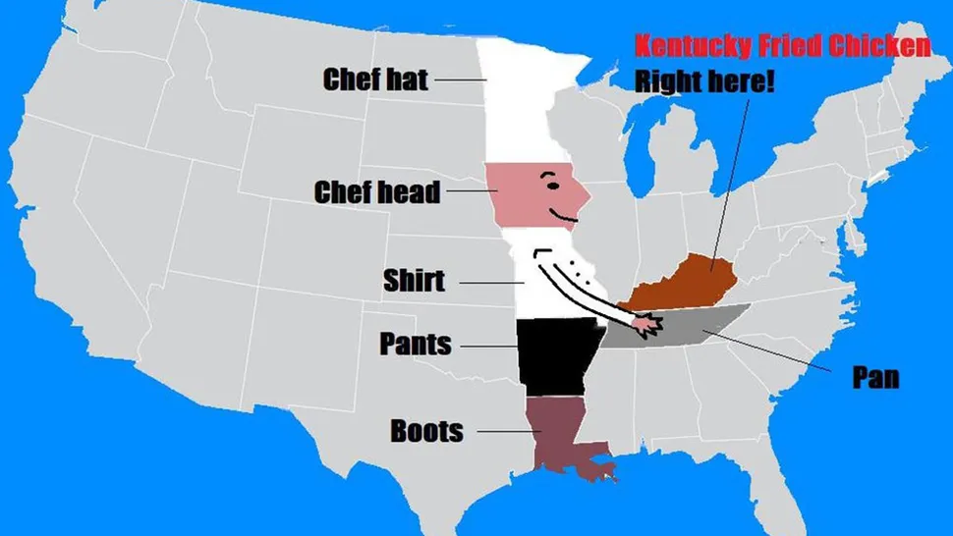
Where is it?
We’re the chef’s hat!
Image credit: r/ReaperMask via Reddit

Slide 5
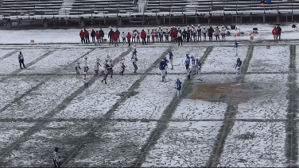
How cold is it?
Me, in highschool

Slide 6
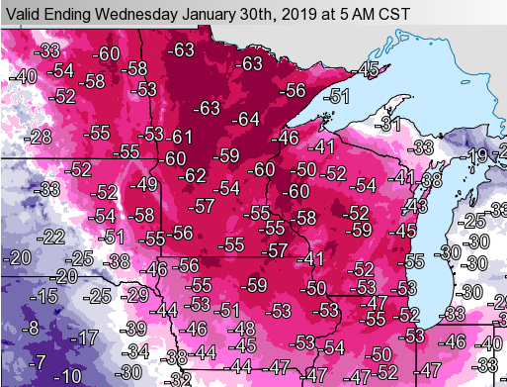
How cold is it, really?
When it actually gets cold
The coldest true temperature (windchill not factored it) I’ve experience is -25 F (-32 C)
Coldest ever recorded: -60 F (-51 C) in 1996
Wind chill (in Fahrenheit)
Image from https://www.weather.gov/arx/jan3019
My backyard

Slide 7
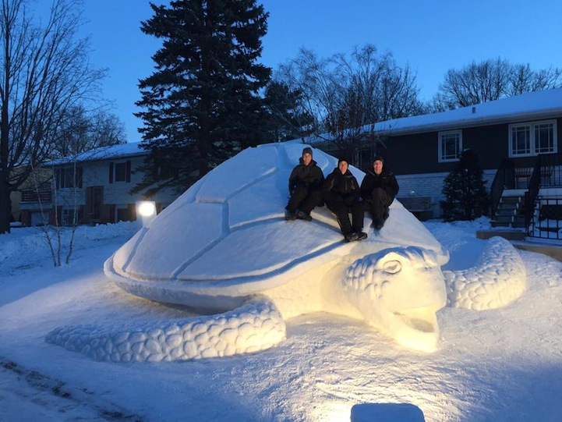
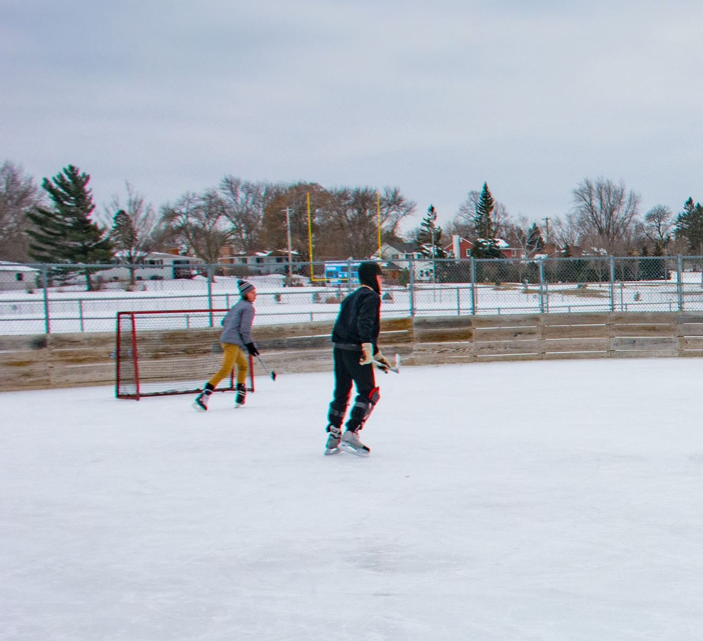
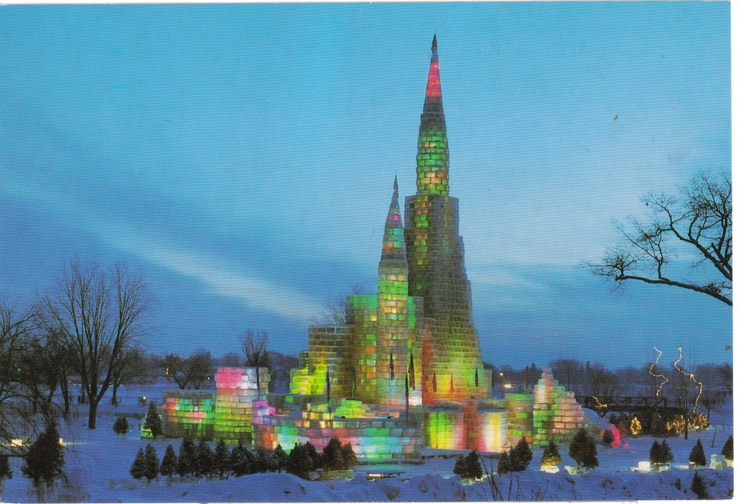
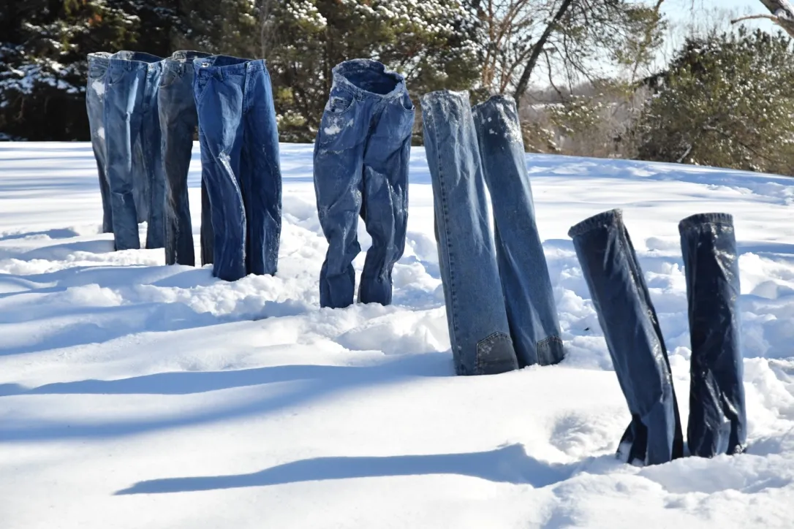
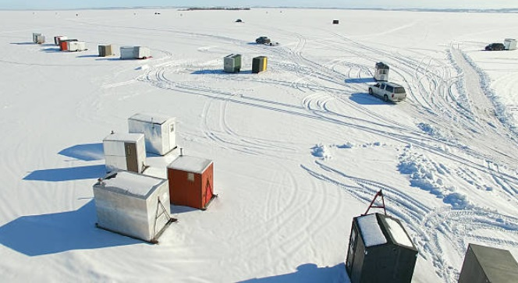
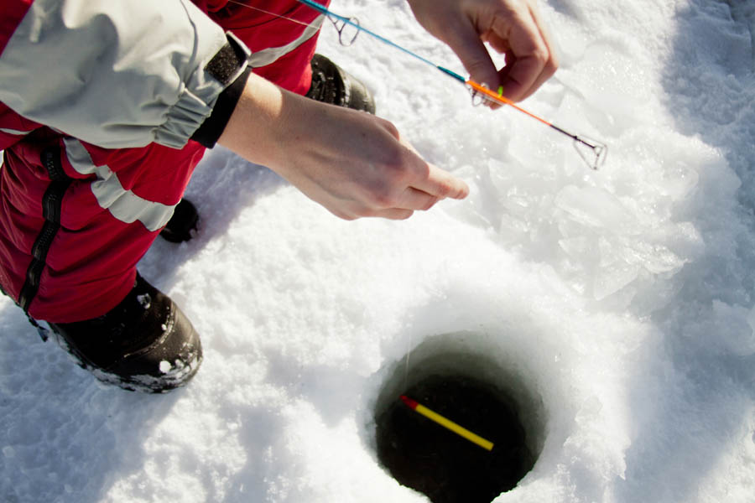
What do people do?
Saint Paul Winter Carnival Ice palace
Bartz Brothers’ snow sculpture
Hockey in the park
Freezing jeans
Ice fishing

Slide 8
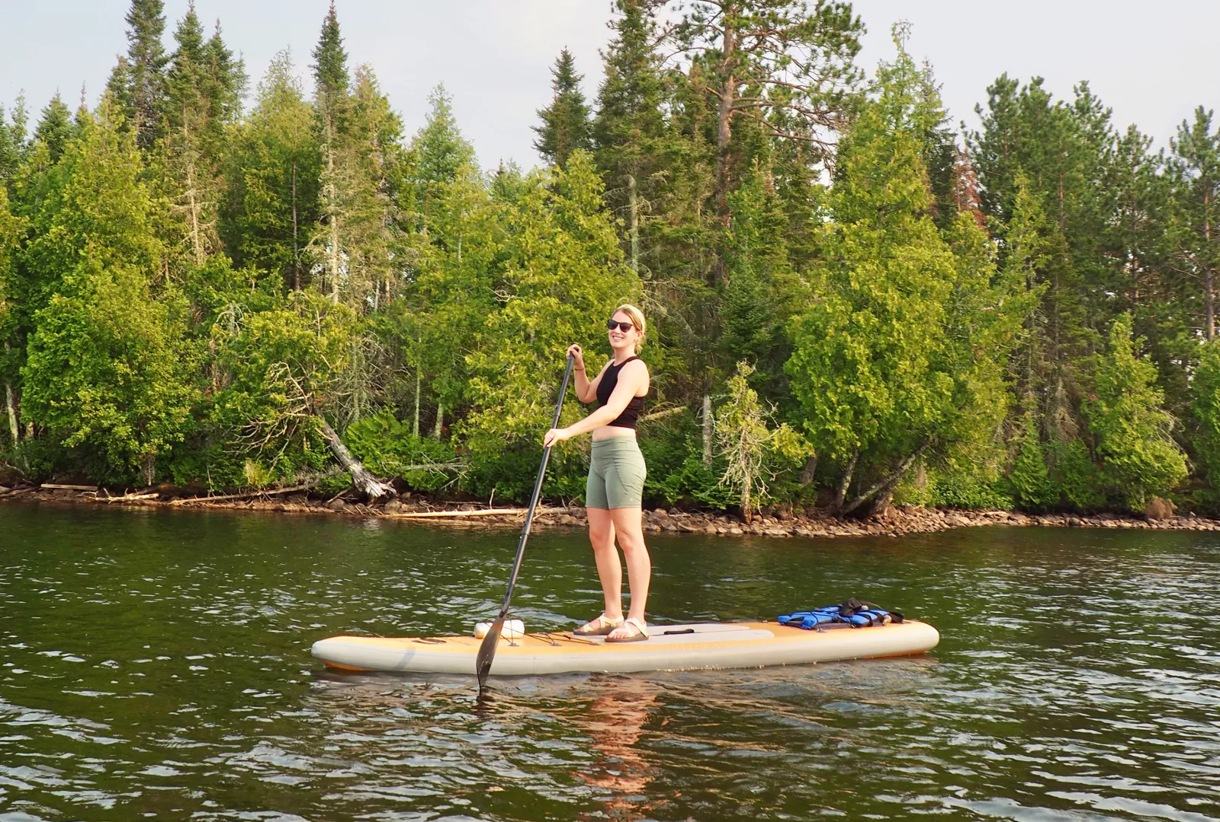
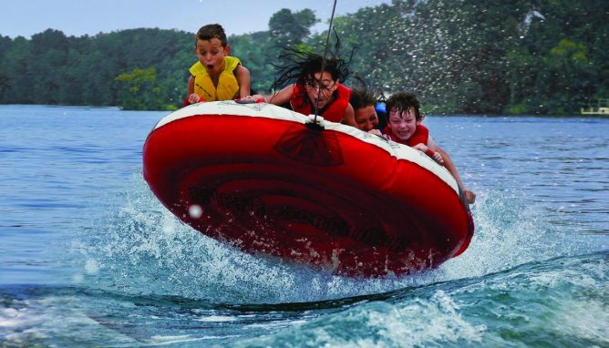
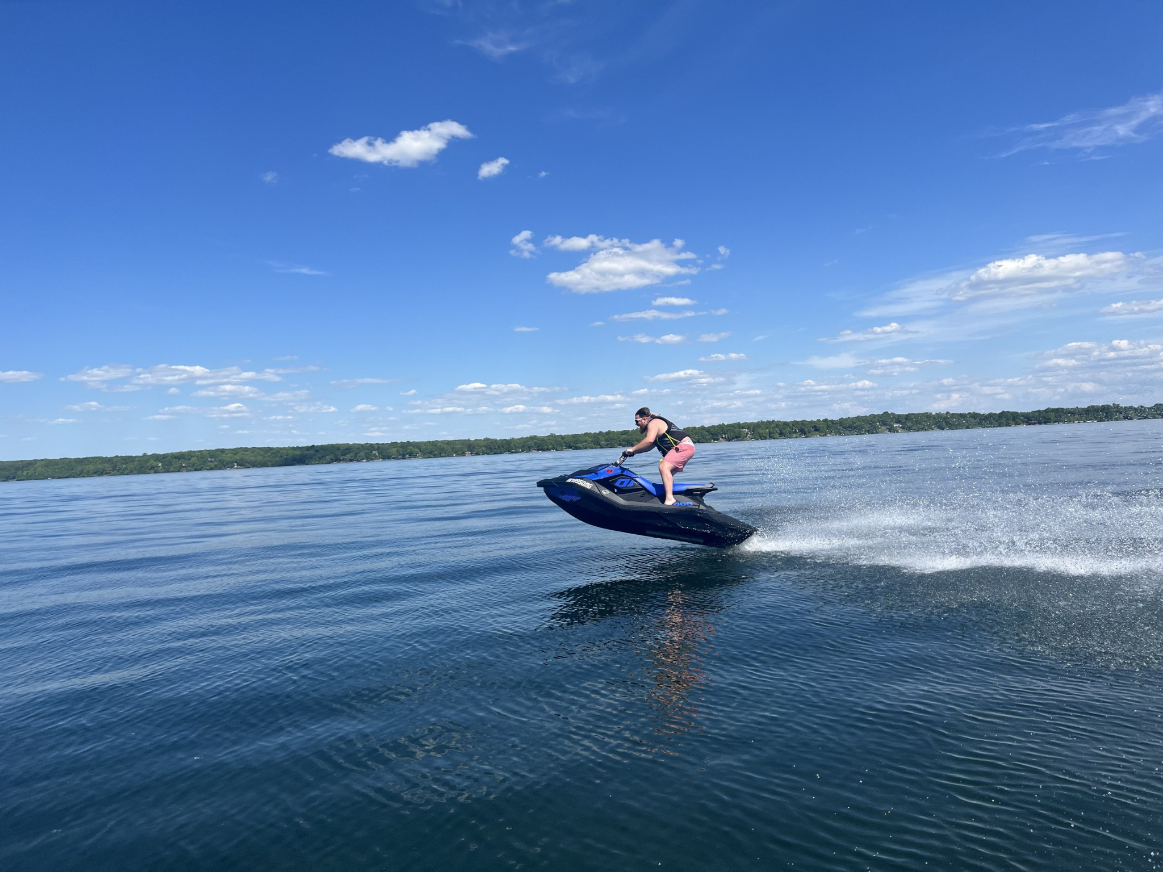
What about the summer?
Our 11,842 lakes melt!

Slide 9
What about the summer?
Our 11,842 lakes melt!
Minnesota Population: 5.7 Million
Number of recreational boats: 0.82 Million (~1 per 7 people)
Source: https://www.statista.com/statistics/1155988/us-recreational-boating-vessels/

Slide 10
What about the summer?
Our 11,842 lakes melt!
Summer objective: make friends with people rich enough to own boats.

Slide 11
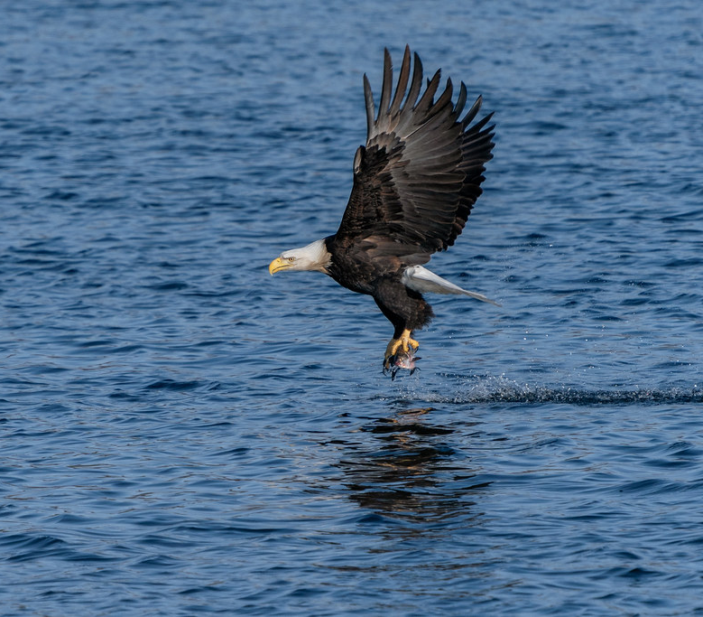
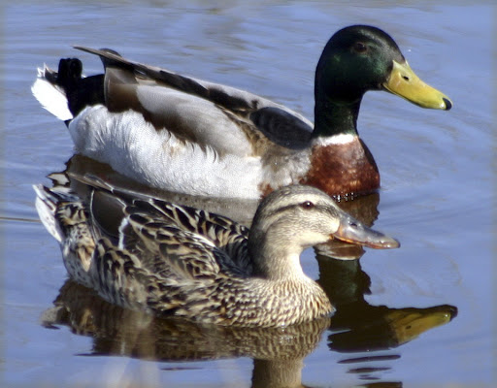
Aquatic Birds
Common Loon
(State Bird)
Bald Eagle
(National Bird)
Mallard Duck
(very common)

Slide 12
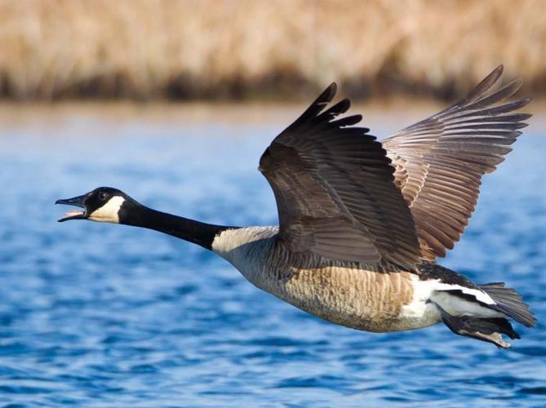
Aquatic Birds
Common Loon
(State Bird)
Bald Eagle
(National Bird)
Mallard Duck
(very common)
Canada goose
F***ing everywhere!

Slide 13
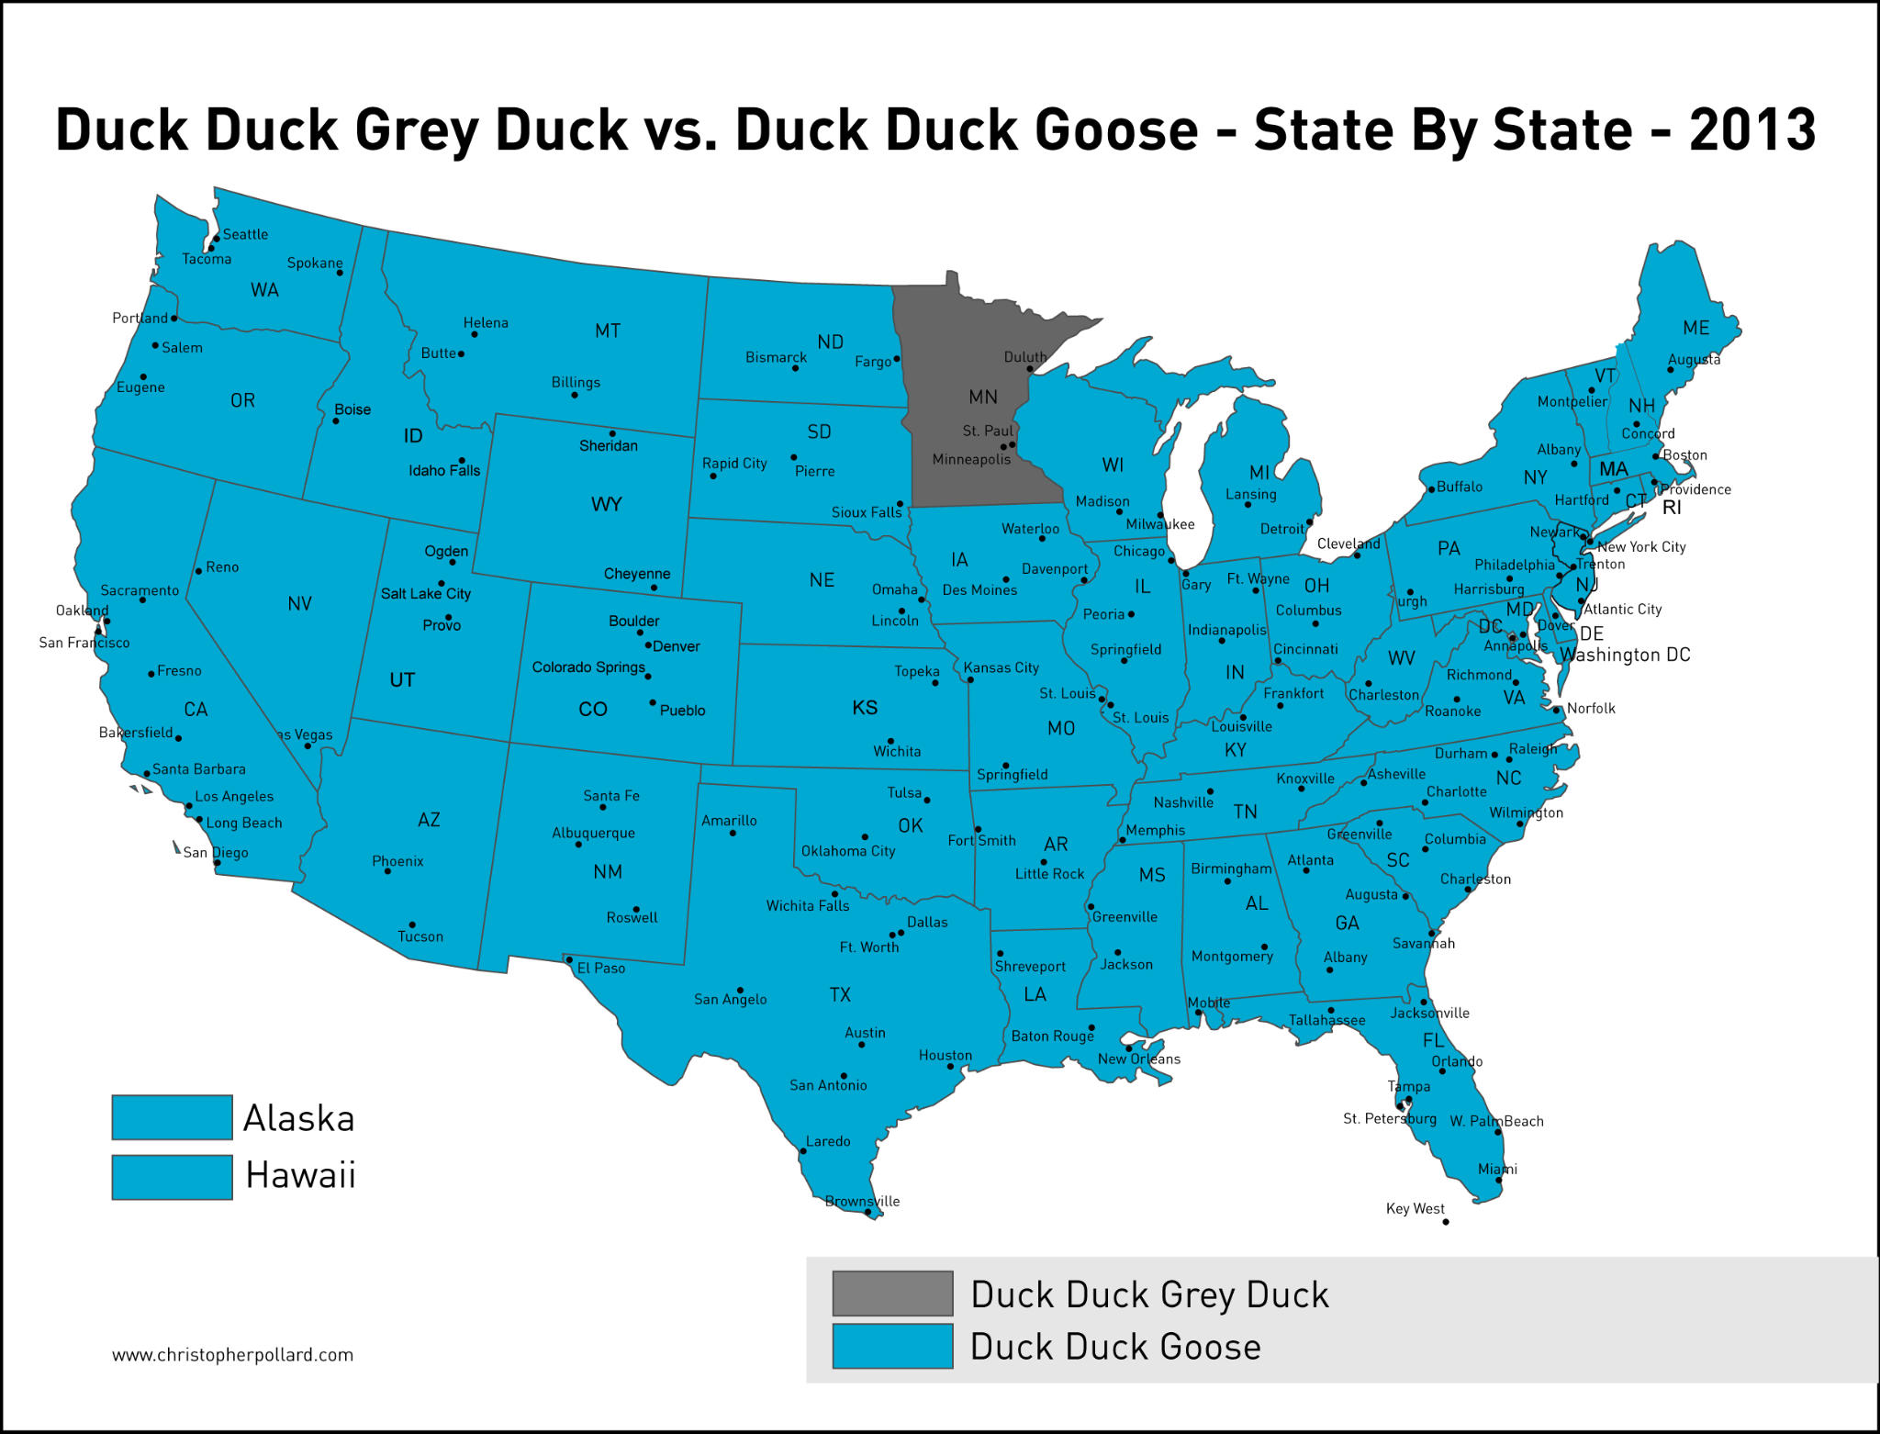
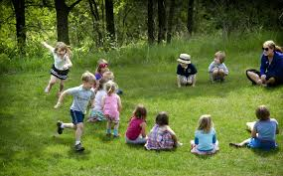
Duck, Duck, Grey Duck
We’re not the weird ones here!

Slide 14
Duck, Duck, Grey Duck
We’re not the weird ones here!
Our version of the game is much better.
People are all different kinds of ducks!
Not just a binary.
Green duck, Gross duck, Golden duck,
Googly-eyed duck, Grey Duck!

Slide 15
What is a grey duck though?
As I’ve already mentioned, we have way too many geese.
I don’t think I’ve ever seen a grey duck in Minnesota
Then why do we call it Duck, Duck, Grey Duck instead of Duck, Duck, Goose?

Slide 16
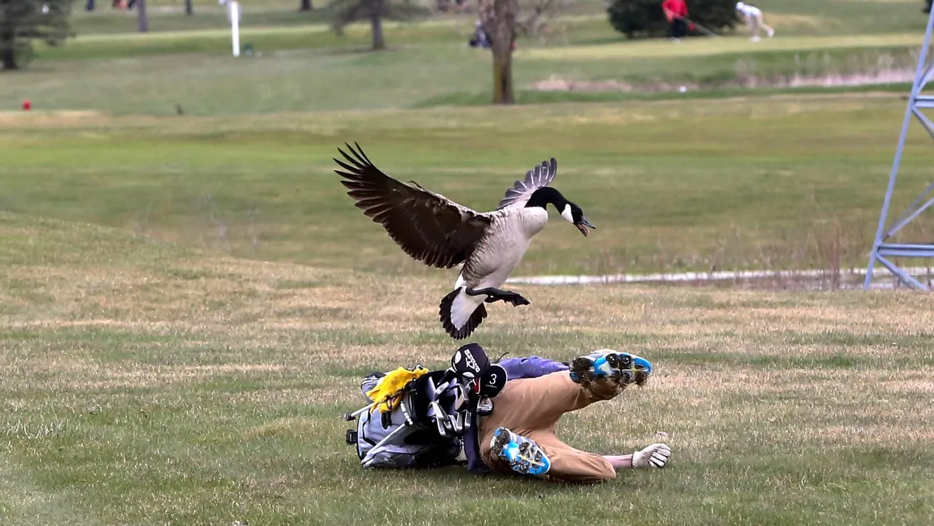
What is a grey duck though?
As I’ve already mentioned, have way too many geese.
I don’t think I’ve ever seen a grey duck in Minnesota.
Then why do we call it Duck, Duck, Grey Duck instead of Duck, Duck, Goose?
My theory:
We fear that saying their name summons them.

Slide 17
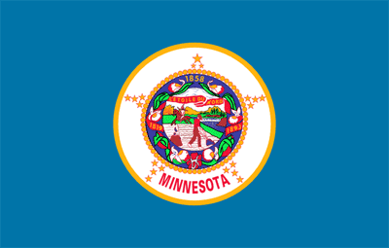
State Flag Drama
The old state flag (sucks!):

Slide 18
State Flag Drama
The old state flag (sucks!):
Busy, hard to recognize from afar.
Just the state seal on a blue background.
Settler-colonial undertones.

Slide 19
State Flag Drama
In December of last year, we changed it to this:
Simple design,
Focuses on the North Star.
Light blue: lakes
Dark blue: Night sky
Based on design by Andrew Prekker

Slide 20
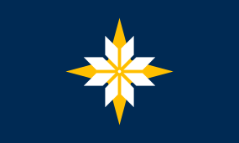
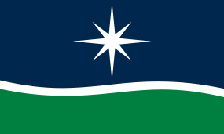


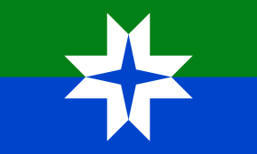

Other popular designs
Brandon Hundt
John Muller
Todd and Peter Pitman
Sarah Agaton Howes
Ross Bruggink
Andrew Prekker

Slide 21
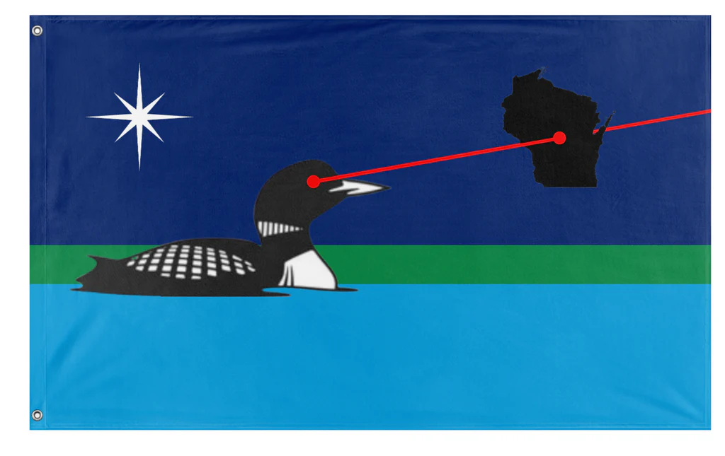
The true best Minnesota flag
Loon shooting lasers at Wisconsin.
(the worst state)
Was officially submitted, but wasn’t a finalist because of cowardly politicians.

Slide 22
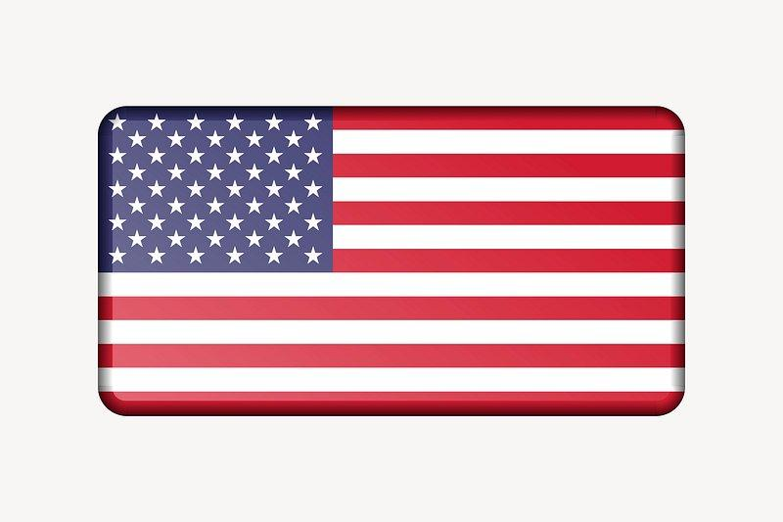
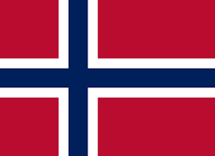
The most popular flag in Minnesota (other than )
The Norwegian flag.
A large portion of Minnesotans descend from Norwegians who immigrated ~1880s.
Many fly the Norwegian flag, even when they’ve never been to Norway.

Slide 23
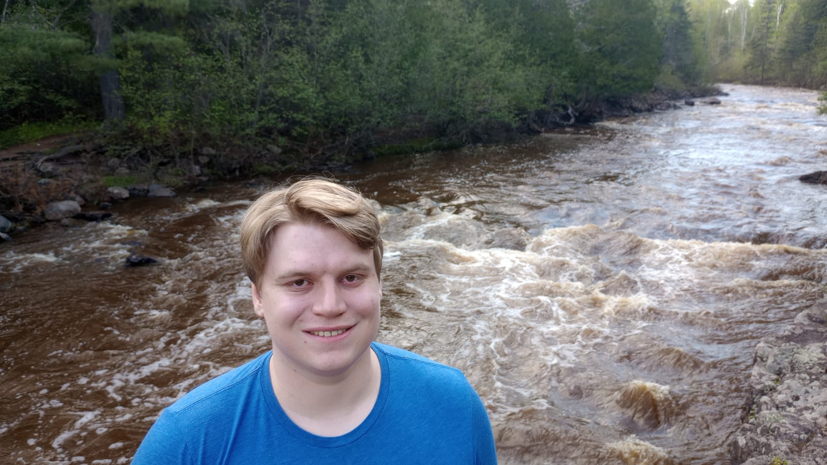
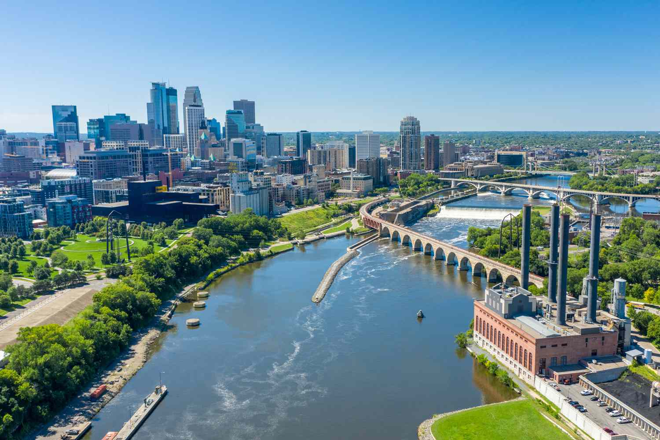
Why everyone should visit Minnesota
The lakes and the nature are beautiful.
Winter is cold, but we embrace it.
Minneapolis recently was ranked #1 happiest city in the US
(#18 in the world) by the The Institute for Quality of Life.

